Slide 1

Testing the Software Architecture
Neeraj Sangal
Lattix, Inc
8 Nov 2006

Slide 2
What you will learn today
A new approach to specify and test software architecture by utilizing inter-module dependencies.
How knowledge of the architecture can help improve your testing
This session includes an actual demo and several real life examples

Slide 3


Agenda
Specify architecture
  What’s a Dependency Structure Matrix (DSM)
  Architectural Patterns
Test the architecture with Design Rules
Demo with a real application
Improve testing with knowledge of architecture
Q & A

Slide 4
Specify the Architecture
(Create the Blueprint)

Slide 5
The DSM Approach
Provides a precise big picture view
of the architecture
Enables explicit testing of architecture
Lightweight approach that does not disrupt current testing or development
Has been applied to a variety of applications (Java, C/C++, .NET …) ranging in size from 100 classes to 20,000 classes

Slide 6
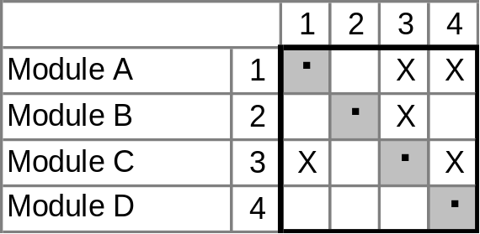
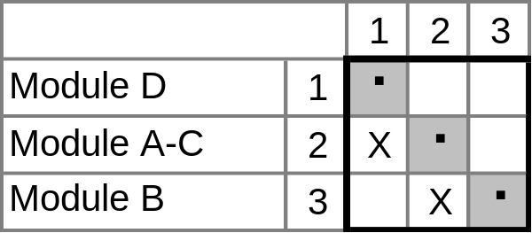
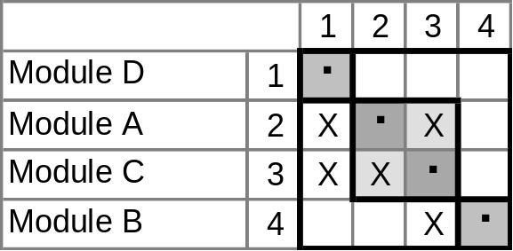
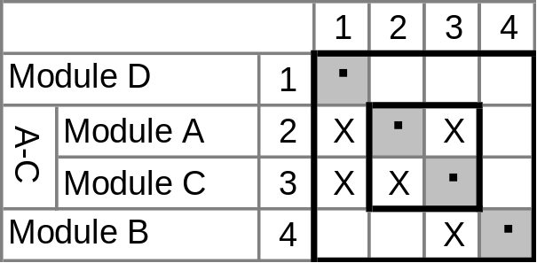
What is a DSM?
  Fig 1: A Simple DSM
  Fig 3: Lower Triangular
  Fig 2: Block Triangular after Partitioning
  Fig 4: Hierarchical

Slide 7
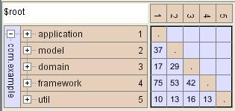
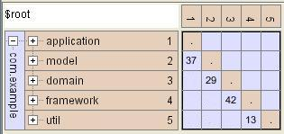
Architectural Patterns - I
Layered System
Strictly Layered System

Slide 8
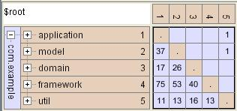
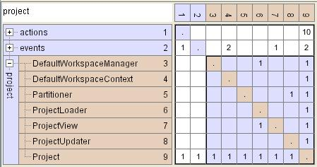
Architectural Patterns - II
Imperfectly Layered System
Change Propagator

Slide 9
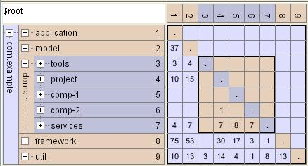
Architectural Patterns - III
Private Components
Not visible outside “domain”

Slide 10
Test the Architecture

Slide 11

Testing the Architecture with Design Rules
Succinct specification of acceptable and unacceptable dependencies between subsystems
Each cell of the DSM represents design intent
DSM offers a powerful way to visualize and specify design rules
Design Rules enable testing of architecture
Dependency Model = DSM + Design Rules

Slide 12
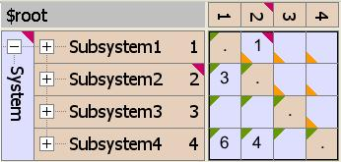
Design Rules
DSM with Rules View
Green Triangle – Dependency Acceptable
Yellow Triangle – Dependency Unacceptable
Red Triangle – Rule Violation Discovered
External rules control library and 3rd party usage
Internal rules are set at highest level of hierarchy and inherited down to lowest level

Slide 13
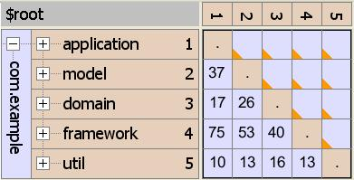
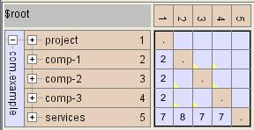
Design Rules
Rules for Layering
$root can-use $root
model cannot-use application
domain cannot-use application, model
framework cannot use application, model, domain
util cannot-use application, model, domain, framework
Independent Components

Slide 14
Demonstration – Specify and Test the Architecture

Slide 15
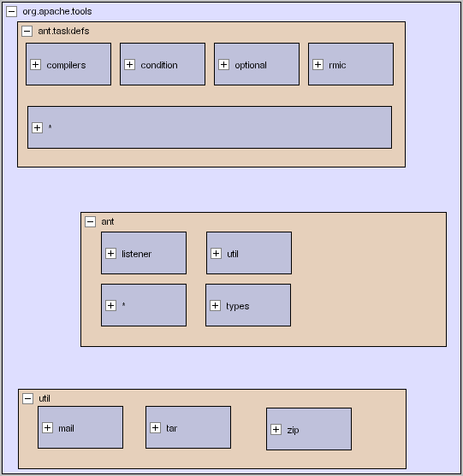
Example: ANT Conceptual Architecture
Layered Architecture with three subsystems
Tasks use common infrastructure
Key Goal: Allow independent development of tasks

Slide 16
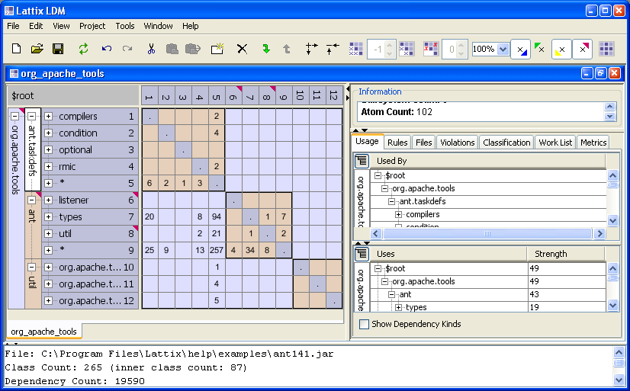
Demonstration

Slide 17
Improve Testing with Architectural Knowledge

Slide 18
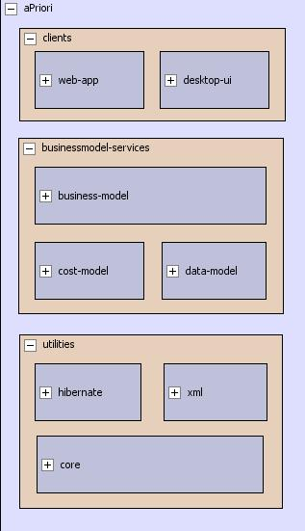
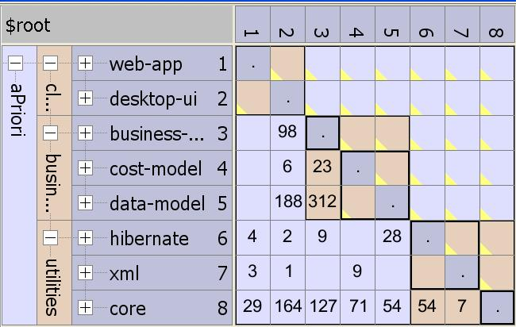
Architectural Visibility improves Testing
Design Rules communicate the intent and enable testing

Slide 19
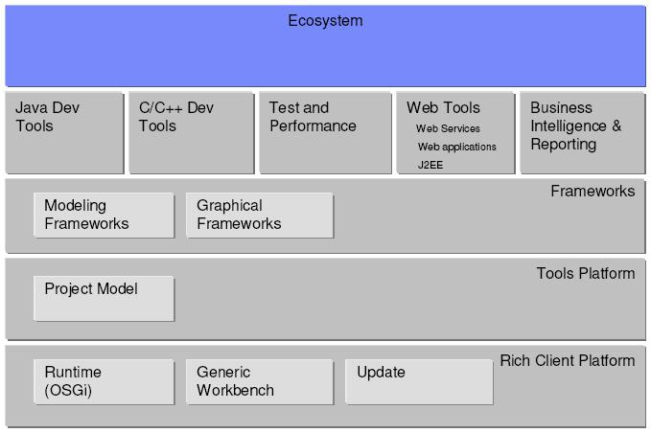
Conceptual Architecture of Eclipse?

Slide 20
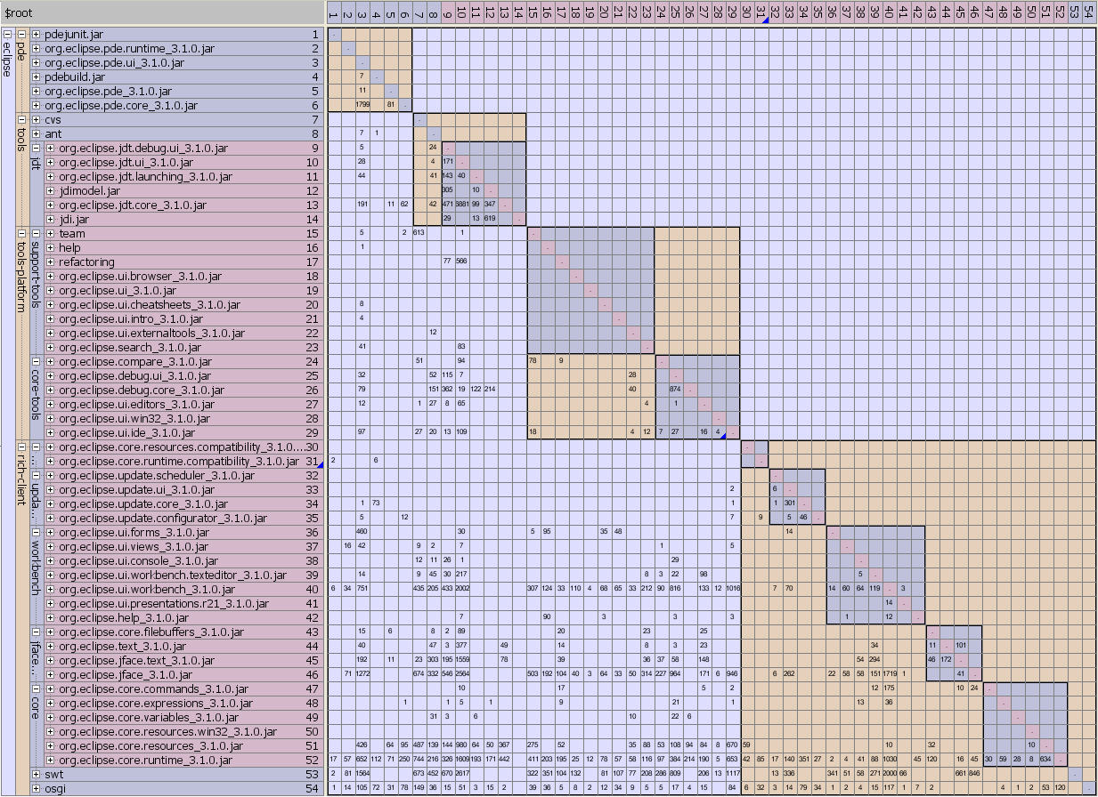
Dependency Model View of Eclipse Platform

Slide 21
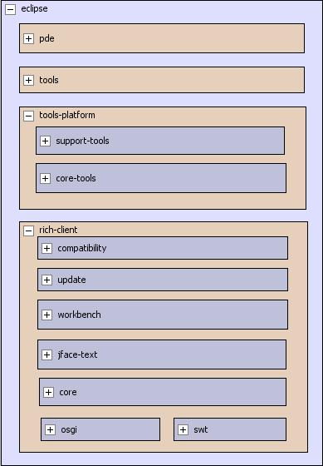
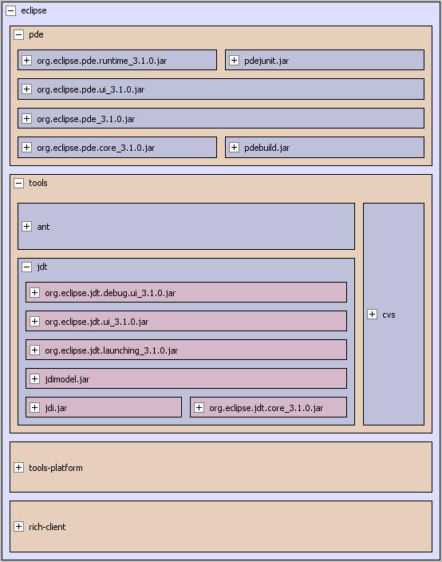
Conceptual Architecture - Eclipse Platform
Precise big picture view derived from the Dependencies
View shows accurate layering and vertical splitting

Slide 22
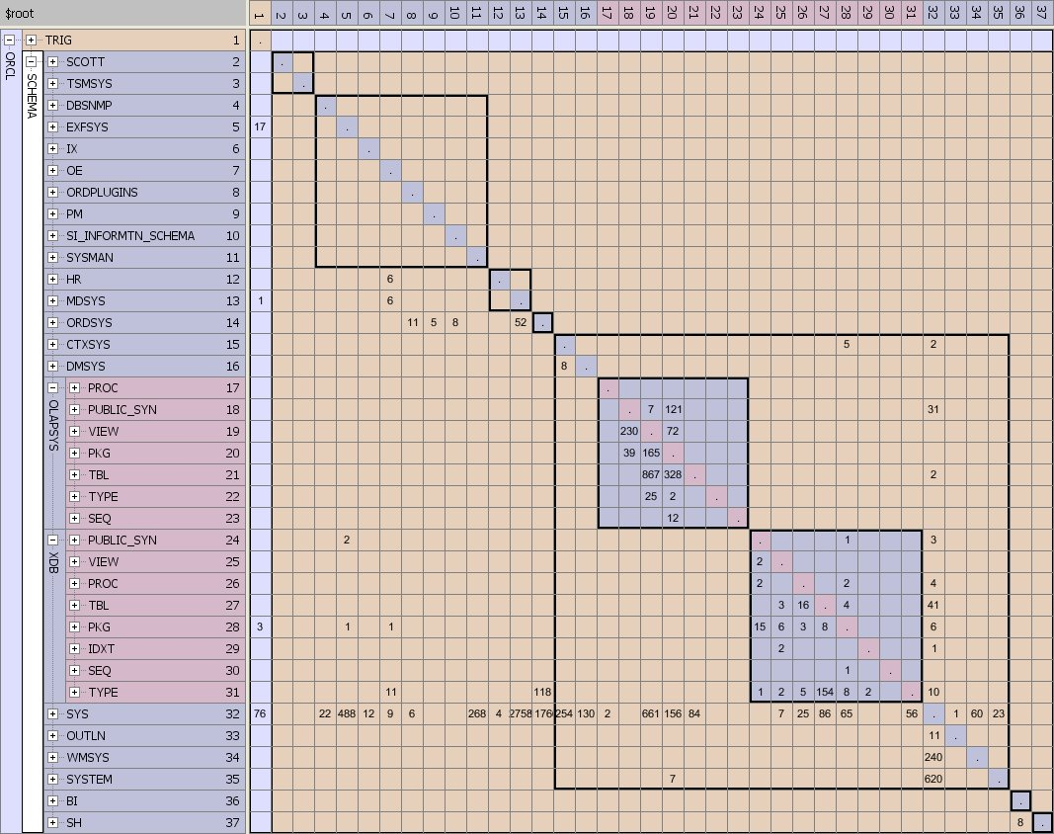
Testing Data Architecture …

Slide 23
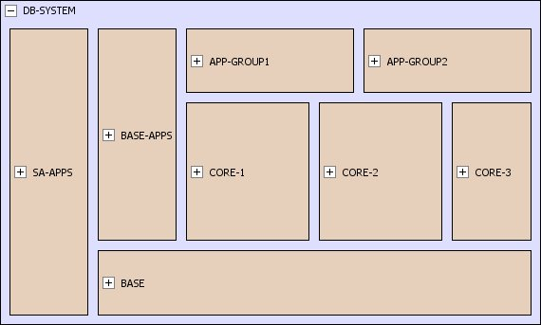
Testing the Data Architecture
Standalone Apps and Base Schemas have no dependencies on the rest of the system
Base Apps have dependencies only on the Base Schemas
The Core Schemas depend only on the Base Schemas
Application Groups 1 and 2 use the Core Schemas and the Base Schemas

Slide 24
Summary: Testing the Big Picture View
Specify the big picture view using DSMs - approach allows you to represent massive systems
Formalize design intent so you can test architectural erosion
Easy to adopt—Use it at any stage
of the lifecycle
Use the knowledge of the architecture to improve your testing

